Slide 1

(old/new) Image sequencer NDVI color map(s)
greyscale
old
stretched
bluwhtgrngis
default/blutored
brwtogrn
new
blutoredjet
colors16

Slide 2

Fastie (VGYRM)
-The left half of the colormap has three gradients between black and white. This does not allow you to discern the value from the tone, but the values of NDVI below zero indicate zero photosynthesis, so we generally do not care exactly what the value is. The multiple gradients preserve the detail of non-plants in the NDVI image. It just makes the NDVI image easier to look at because you can recognize objects and textures that are not foliage.
-The boundary between grayscale and color is not at zero. Live foliage generally does not have NDVI values below 0.1, so that is the boundary between grayscale and color. With this colormap, anything in grayscale is probably not a plant. This allows a more precise differentiation between plant and non-plant when the NDVI values are calibrated.
-There is a narrow band of violet between 0.1 and 0.2 which could represent very low photosynthetic activity, but might also be noise or error.
-The primary gradient of photosynthetic activity is from NDVI values from 0.2 to 0.9, and that is represented with a classic heat map from green to yellow to red. It's a little bit counter intuitive because green does not represent the healthiest plants, but the heat map metaphor seems to work well for most people.
-The highest values (> 0.9) are colored magenta. Foliage generally does not have NDVI values this high, so this color represents non-plants. I did not make it a gray so it can be distinguished from low values. In many cases, DIY NDVI values above 0.9 are artifacts where the image is very dark or very bright.
NDVI_VGYRM.lut
fastie: colormap([
[0, [255, 255, 255], [0, 0, 0] ],
[0.167, [0, 0, 0], [255, 255, 255] ],
[0.33, [255, 255, 255], [0, 0, 0] ],
[0.5, [0, 0, 0], [140, 140, 255] ],
[0.55, [140, 140, 255], [0, 255, 0] ],
[0.63, [0, 255, 0], [255, 255, 0] ],
[0.75, [255, 255, 0], [255, 0, 0] ],
[0.95, [255, 0, 0], [255, 0, 255] ]
])
Image sequencer
https://publiclab.org/notes/cfastie/08-26-2014/new-ndvi-colormap

Slide 3


bluwhtgrngis
bluwhtgrngis: colormap([
[0, [6,23,86], [6,25, 84] ],
[0.0625, [6,25,84], [6,25, 84] ],//1
[0.125, [6,25,84], [6,25, 84] ],//2
[0.1875, [6,25,84], [6,25, 84] ],
[0.25, [6,25,84], [6,25,84] ],
[0.3125, [6,25,84], [9,24, 84] ],//5
[0.3438, [9,24, 84], [119,120,162] ],//5
[0.375, [119,129,162],[249,250,251] ], //6
[0.406, [249,250,251],[255,255,255] ], //6.5
[0.4375, [255,255,255],[255,255,255] ], //7 white
[0.50, [255,255,255],[214,205,191] ],//8
[0.52, [214,205,191],[178,175,96] ],//8.2
[0.5625, [178,175,96], [151,176,53] ],//9
[0.593, [151,176,53], [146,188,12] ],//9.5
[0.625, [146,188,12], [96,161,1] ], //10
[0.6875, [96,161,1], [30,127,3] ],//11
[0.75, [30,127,3], [0,99,1] ],//12
[0.8125, [0,99,1], [0,74,1] ],//13
[0.875, [0,74,1], [0,52, 0] ],//14
[0.9375, [0,52, 0], [0,34,0] ], //15
[0.968, [0,34,0], [68,70,67] ] //16
]),
Obtained form the open source geospatial wiki:
https://grasswiki.osgeo.org/wiki/File:Colortable_ndvi.png
Image sequencer

Slide 4
default/blutored
Based on a continuous lut from ImageJ called Physics. Produces a good heatmap with values below zero colored blue or green. Plants should be green to orange.
default: colormap([
[0, [45,1,121], [25,1,137] ],
[0.125, [25,1,137], [0,6,156] ],
[0.1875, [0,6,156], [7,41,172] ],
[0.25, [7,41,172], [22,84,187] ],
[0.3125, [22,84,187], [25,125,194] ],
[0.375, [25,125,194], [26,177,197] ],
[0.4375, [26,177,197], [23,199,193] ],
[0.47, [23,199,193], [25, 200,170] ],
[0.50, [25, 200,170], [21,209,27] ],
[0.5625, [21,209,27], [108,215,18] ],
[0.625, [108,215,18], [166,218,19] ],
[0.6875, [166,218,19], [206,221,20] ],
[0.75, [206,221,20], [222,213,19 ] ],
[0.7813, [222,213,19], [222, 191, 19]],
[0.8125, [222, 191, 19], [227,133,17] ],
[0.875, [227,133,17], [231,83,16] ],
[0.9375, [231,83,16], [220,61,48] ]
]),
https://publiclab.org/wiki/ndvi-gradients
Image sequencer

Slide 5
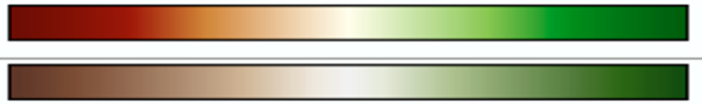
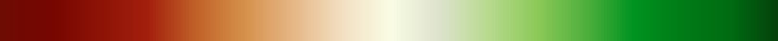
brntogrn (NDVI Anomaly)
brntogrn: colormap([
[0, [110,12,3], [118,6,1] ],
[0.0625, [118,6,1], [141,19,6] ],
[0.125, [141,19,6], [165,35,13] ],
[0.1875, [165,35,13], [177,59,25] ],
[0.2188, [177,59,25], [192,91,36] ],
[0.25, [192,91,36], [214, 145, 76] ],
[0.3125, [214,145,76], [230,183,134] ],
[0.375, [230,183,134],[243, 224, 194]],
[0.4375, [243,224,194],[250,252,229] ],
[0.50, [250,252,229],[217,235,185] ],
[0.5625, [217,235,185],[184,218,143] ],
[0.625, [184,218,143],[141,202,89] ],
[0.6875, [141,202,89], [80,176,61] ],
[0.75, [80,176,61], [0, 147, 32] ],
[0.8125, [0,147,32], [1, 122, 22] ],
[0.875, [1,122,22], [0, 114, 19] ],
[0.90, [0,114,19], [0,105,18] ],
[0.9375, [0,105,18], [7,70,14] ]
]),
Colorbar obtained from NASA website
to show plants under stress (drought)
https://earthobservatory.nasa.gov/images/50328/drought-in-texas
Image sequencer

Slide 6
blutoredjet
blutoredjet: colormap([
[0, [0,0,140], [1,1,186] ],
[0.0625, [1,1,186], [0,1,248] ],
[0.125, [0,1,248], [0,70,254] ],
[0.1875, [0,70,254], [0,130,255] ],
[0.25, [0,130,255], [2,160,255] ],
[0.2813, [2,160,255], [0,187,255] ], //inset
[0.3125, [0,187,255], [6,250,255] ],
// [0.348, [0,218,255], [8,252,251] ],//inset
[0.375, [8,252,251], [27,254,228] ],
[0.406, [27,254,228], [70,255,187] ], //insert
[0.4375, [70,255,187], [104,254,151]],
[0.47, [104,254,151],[132,255,19] ],//insert
[0.50, [132,255,19], [195,255,60] ],
[0.5625, [195,255,60], [231,254,25] ],
[0.5976, [231,254,25], [253,246,1] ],//insert
[0.625, [253,246,1], [252,210,1] ], //yellow
[0.657, [252,210,1], [255,183,0] ],//insert
[0.6875, [255,183,0], [255,125,2] ],
[0.75, [255,125,2], [255,65, 1] ],
[0.8125, [255,65, 1], [247, 1, 1] ],
[0.875, [247,1,1], [200, 1, 3] ],
[0.9375, [200,1,3], [122, 3, 2] ]
]),
-developed from matpltlib ‘Jet’ colormap
-Green shifted to right
https://matplotlib.org/tutorials/colors/colormaps.html
Image sequencer

Slide 7

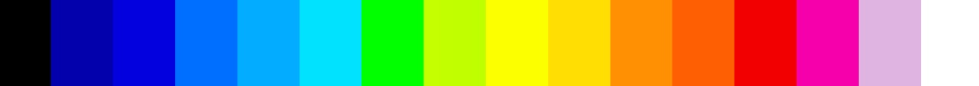
colors16
discreet class lut from ImageJ called 16colors
colors16: colormap([
[0, [0,0,0], [0,0,0] ],
[0.0625, [3,1,172], [3,1,172] ],
[0.125, [3,1,222], [3,1, 222] ],
[0.1875, [0,111,255], [0,111,255] ],
[0.25, [3,172,255], [3,172,255] ],
[0.3125, [1,226,255], [1,226,255] ],
[0.375, [2,255,0], [2,255,0] ],
[0.4375, [198,254,0], [190,254,0] ],
[0.50, [252,255,0], [252,255,0] ],
[0.5625, [255,223,3], [255,223,3] ],
[0.625, [255,143,3], [255,143,3] ],
[0.6875, [255,95,3], [255,95,3] ],
[0.75, [242,0,1], [242,0,1] ],
[0.8125, [245,0,170], [245,0,170] ],
[0.875, [223,180,225], [223,180,225] ],
[0.9375, [255,255,255], [255,255, 255]]
]),
A discreet class lut from ImageJ called ‘16colors’.. Produces a good heatmap with the highest values (which should not be plants) colored dull pink or white. Good for troubleshooting the high end. Plants should be yellow to red.
https://publiclab.org/wiki/ndvi-gradients
Image sequencer

Slide 8
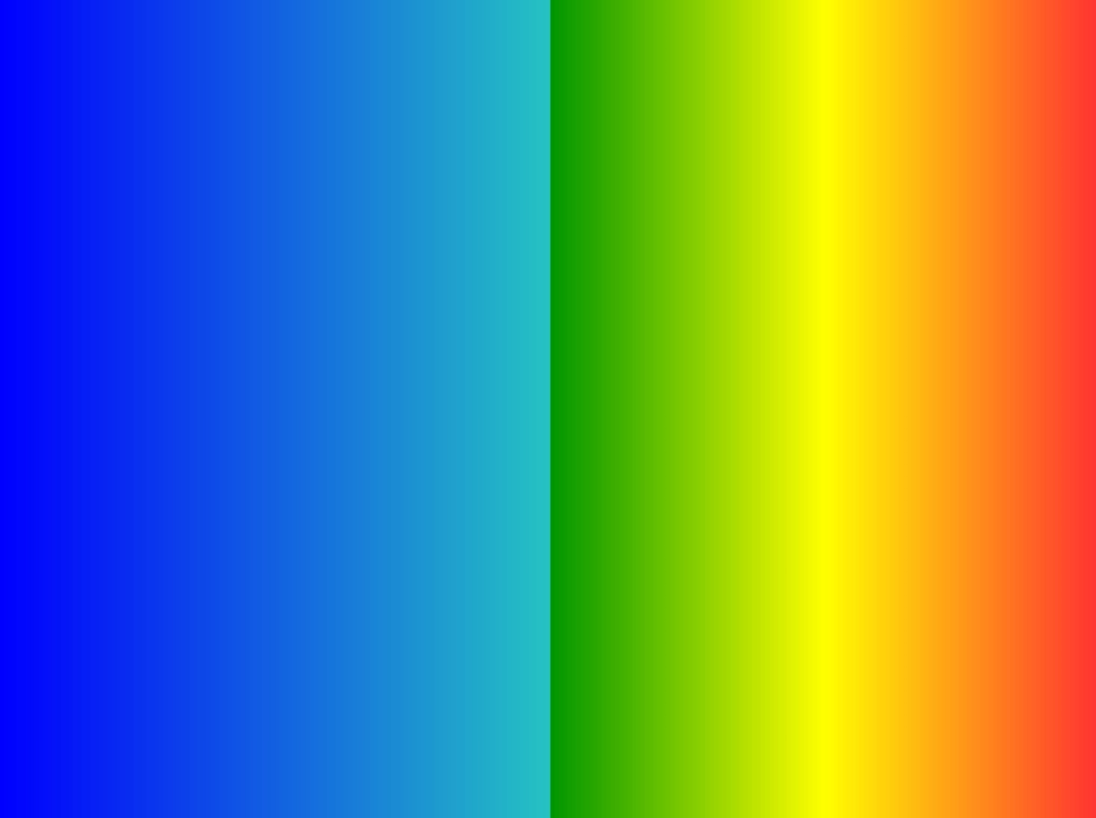
stretched
ndvi
ndvi: colormap([
[0, [0, 0, 255], [38, 195, 195] ],
[0.5, [0, 150, 0], [255, 255, 0] ],
[0.75, [255, 255, 0], [255, 50, 50] ]
]),
-ndvi colormap close to ‘stretched’
-only difference is .1 and .9 settings
-not used in image sequencer
A variant of the physics lut. This distinguishes NDVI values below zero by making them blue, but retains the gradient so details of the non-plant scene can be discerned. The magenta for values ~0.9 and higher allows troubleshooting of high values. Plants should be greenish yellow to red
stretched: colormap([
[0, [0, 0, 255], [0, 0, 255] ],
[0.1, [0, 0, 255], [38, 195, 195] ],
[0.5, [0, 150, 0], [255, 255, 0] ],
[0.7, [255, 255, 0], [255, 50, 50] ],
[0.9, [255, 50, 50], [255, 50, 50] ]
]),
https://publiclab.org/wiki/ndvi-gradients

Slide 9
Greyscale
greyscale: colormap([
[0, [0, 0, 0], [255, 255, 255] ],
[1, [255, 255, 255], [255, 255, 255] ]
]),
Image sequencer

